Slide 1
Accountability Update
Ty Duncan
Coordinator of Accountability and Compliance, ESC 17
@instructionalle

Slide 2
Blog for Handouts!!

Slide 3
Performance Index Framework
For 2013 and beyond, a framework of four Performance Indexes will include a broad set of measures that provide a comprehensive evaluation of the entire campus or district.
Accountability System
Student Achievement
Index I
Student Progress
Index 2
Closing Performance Gaps
Index 3
Postsecondary Readiness
Index 4
Student Achievement
Index I
Postsecondary Readiness
Index 4
Student Progress
Index 2
Closing Performance Gaps
Index 3

Slide 4
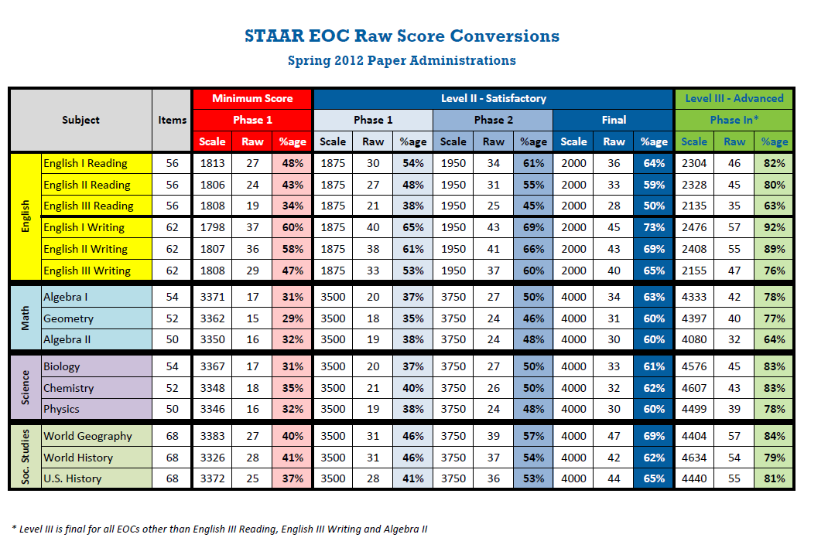

Slide 5
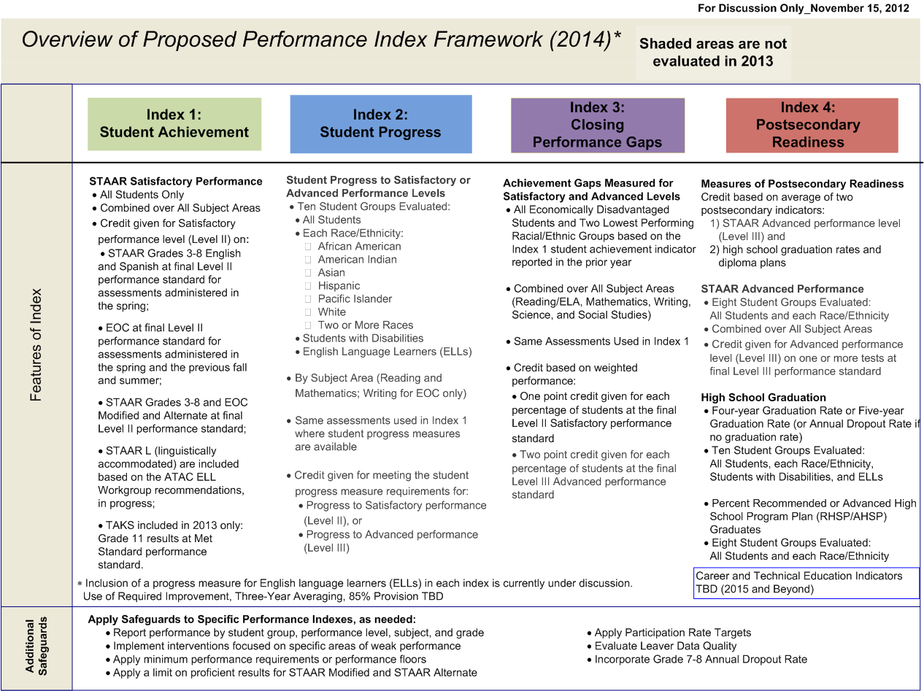
Overview of Proposed Performance Index Framework (Old Version)

Slide 6
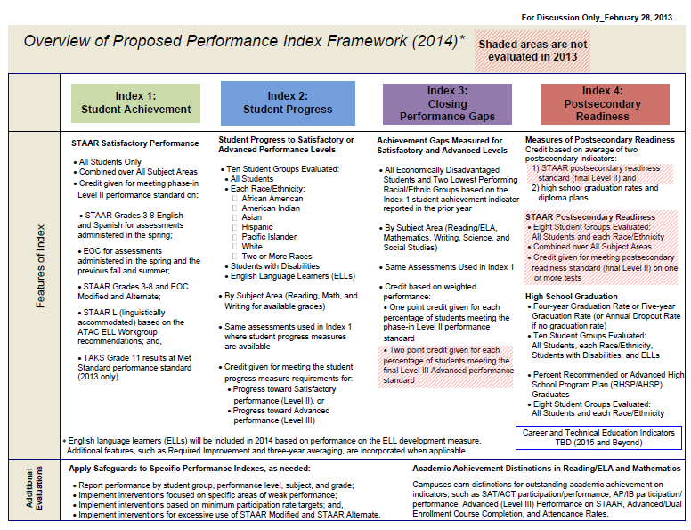
Overview of Proposed Performance Index Framework (As of Feb. 28th, 2013)

Slide 7
Index 1: Student Achievement
Sample Campus STAAR Performance Results
STAAR Performance Results | % Met Level II or III
STAAR Reading | 50%
STAAR Mathematics | 38%
STAAR Writing | 45%
STAAR Science | 25%
STAAR Social Studies | 83%

Slide 8
Index 1: Student Achievement
STAAR Percent Met Level II Standard (2013 and Beyond)
STAAR Grades 3-8 English and Spanish at final Level II performance standard for assessments administered in the spring;
EOC at final Level II performance standard for assessments administered in the spring and the previous fall and summer;
STAAR Grades 3-8 and EOC Modified and Alternate at final Level II performance standard;
TAKS 2013: Grade 11 results at Met Standard performance 2014 and beyond: None

Slide 9
Index 1: Student Achievement
STAAR Percent Met Level II Standard (2013 and Beyond)
Combined over all subject areas: Reading, Mathematics, Writing, Science, and Social Studies
Student groups: All Students only
Students below Grade 9 taking EOC courses: Administrative rules for the assessment program will require that students be administered the EOC test rather than the STAAR grade level assessment for the subject.

Slide 10
Index 1: Student Achievement
Index 1 Construction
Since Index 1 has only one indicator, the Total Index Points and Index Score are the same: Index Score = Total Index Points. Total Index Points is the percentage of assessments that met the final Level II Standard.
Each percent of students meeting the final Level II performance standard contributes one point to the index. Index scores range from 0 to 100 for all campuses and districts.
Example
 | Reading |  | Mathematics |  | Writing |  | Science |  | Social Studies |  | Total | % Met Level II
Students Met Level II | 50 | + | 38 | + | 19 | + | 10 | + | 19 | = | 136 | 45% | 45
Students Tested | 100 | + | 100 | + | 42 | + | 40 | + | 23 | = | 305
Index Score |  |  |  |  |  |  |  |  |  |  |  |  | 45

Slide 11
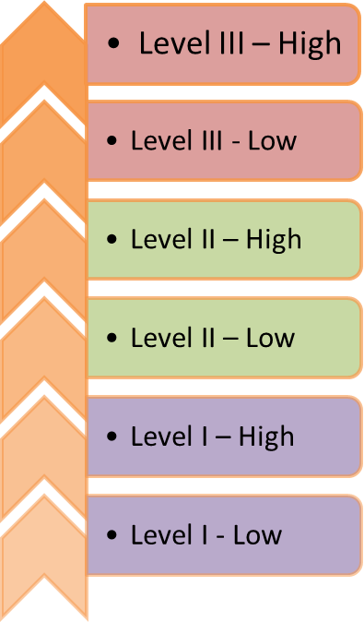
Index 2: Student Progress
STAAR Percent Met Growth Standard (2014 and Beyond)
The STAAR growth measure will not available in time for use in the 2013 accountability ratings. Since the growth measure must be finalized based on the spring 2013 STAAR results, it is not possible to set the 2013 accountability targets for Index 2 prior to the release date of the 2013 ratings.
This graphic is an example of a transition table that divides the three STAAR performance levels (Level I, Level II, and Level III) into performance bands.
The number of bands within a performance level
may differ for the final growth measure adopted.

Slide 12
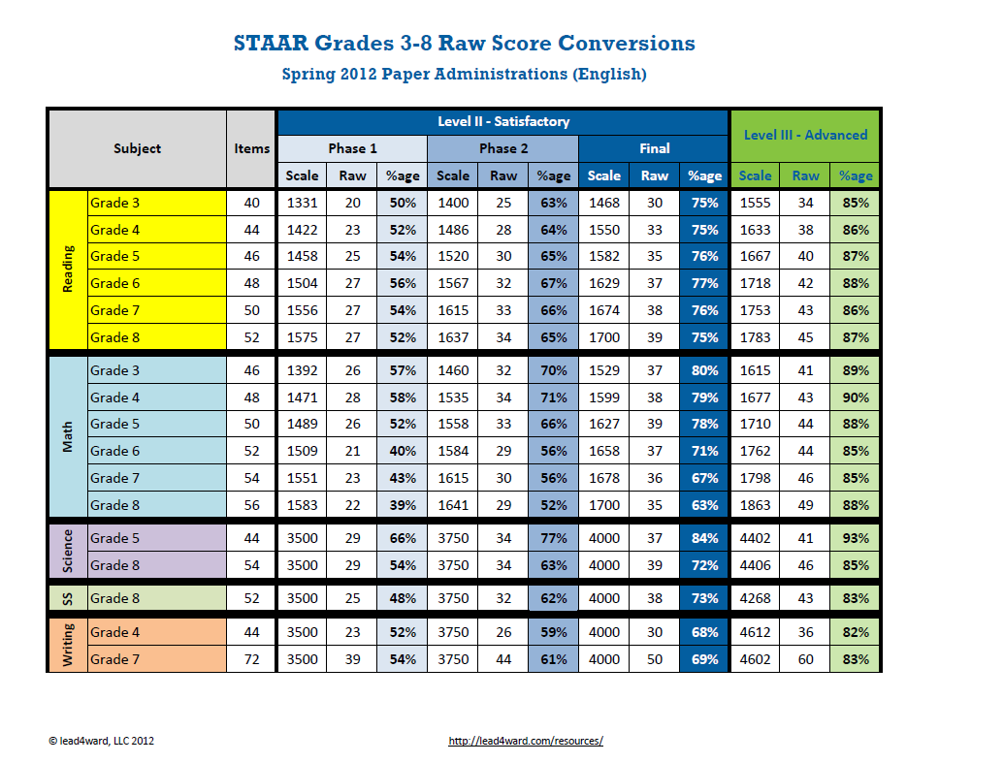

Slide 14
Index 2: Student Progress
Index 2 Construction
Ten Student Groups Evaluated:
All Students
English language learners (ELLs)
Students with Disabilities
Race/Ethnicity:
African American
American Indian
Asian
Hispanic
Pacific Islander
White
Two or More Races

Slide 15
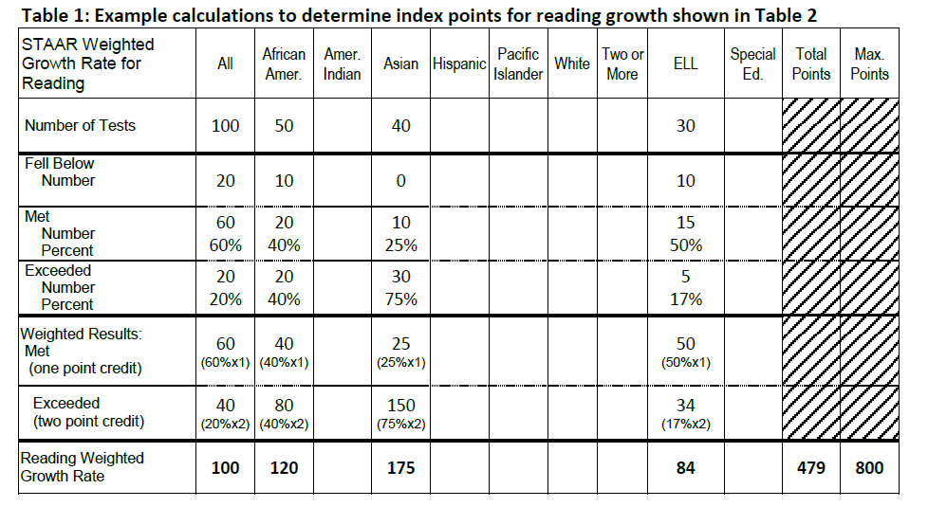
Index 2: Student Progress

Slide 16
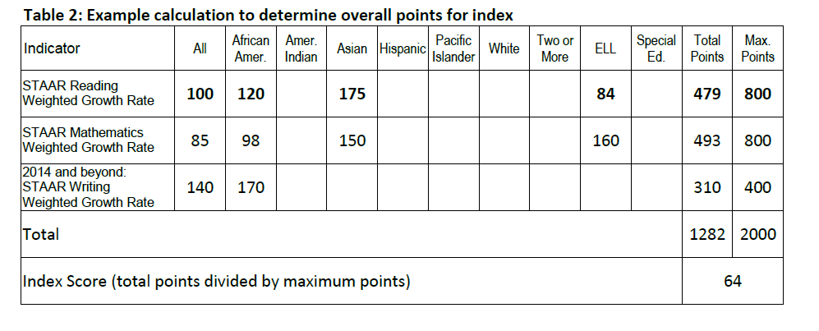
Index 2: Student Progress

Slide 17
Index 3: Closing Performance Gaps
STAAR Weighted Performance (2013 and beyond)
Two approaches to evaluating progress toward closing performance gaps:
Compare the performance of the lower performing student group to the performance of a higher performing student group over time, or
Compare the performance of the lower performing student group to an external target, the performance target that is tied to the statutory and accountability goal that Texas will be among the top ten states in postsecondary readiness by 2020 with no significant achievement gaps by race, ethnicity, or socioeconomic status.
Index 3 takes the second approach through a weighted performance index.

Slide 18
Index 3: Closing Performance Gaps
STAAR Weighted Performance (2013 and beyond)
Index 3 ensures that individual student groups are not ignored within the performance index framework.
Credit based on weighted performance:
Level II satisfactory performance (2013 and beyond) One point for each percent of students at the final Level II satisfactory performance standard.
Level II Final Performance(2014 and beyond) Two points for each percent of students at the final Level III advanced performance standard.

Slide 19
Index 3: Closing Performance Gaps
Index 3 Construction
Assessment results include all assessments that are included in the Index 1 student achievement indicator.
By Subject Area: Reading, Mathematics, Writing, Science, and Social Studies.
Student Groups
Socioeconomic: Economically Disadvantaged
Lowest Performing Race/Ethnicity: The two lowest performing race/ ethnicity student groups on the campus or district (based on prior-year assessment results).
The STAAR weighted performance rate calculation must be modified for 2013 because STAAR Level III advanced performance cannot be included in the indicator until 2014.

Slide 20
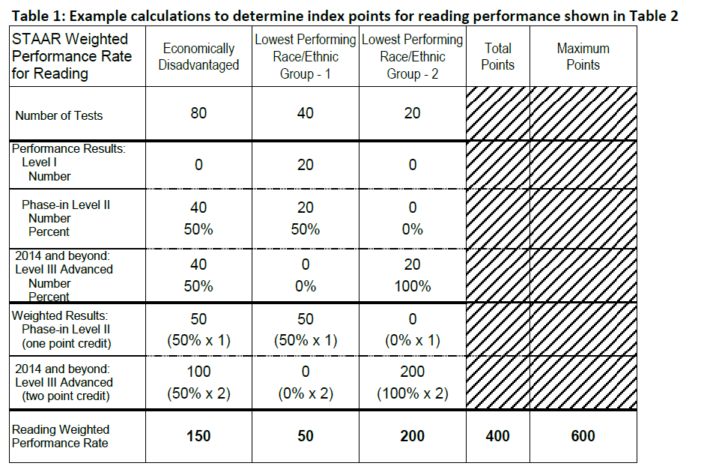
Index 3: Closing Performance Gaps
Index 3 Construction
20

Slide 21
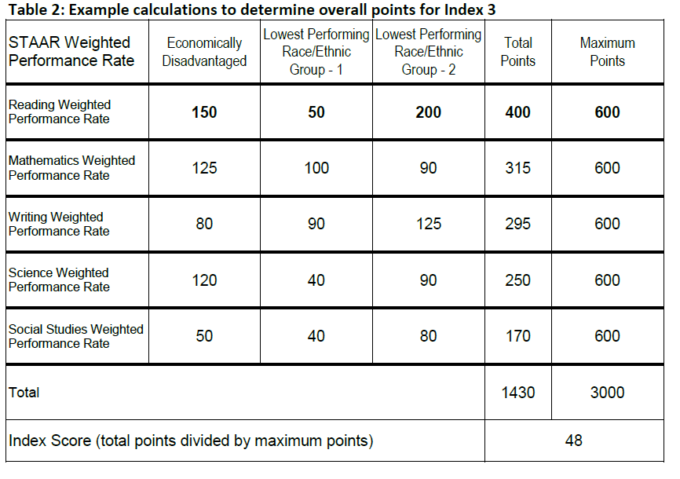
Index 3: Closing Performance Gaps

Slide 22
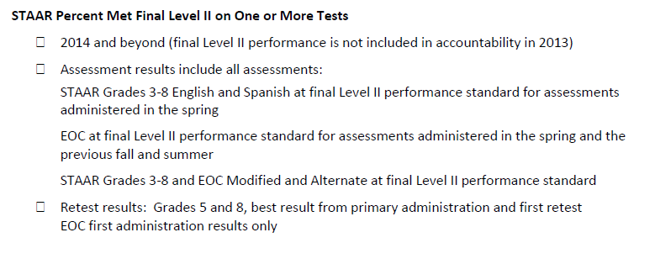
Index 4: Postsecondary Readiness

Slide 23
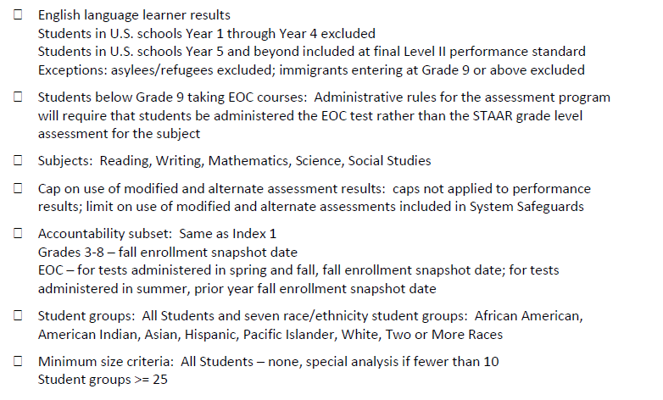
Index 4: Postsecondary Readiness

Slide 24
Index 4: Postsecondary Readiness
Graduation Rates
High School Graduation
Four-year Graduation Rate or Five-year Graduation Rate (or Annual Dropout Rate if no graduation rate)
Ten Student Groups Evaluated:
All Students
English language learners (ELLs)
Students with Disabilities
Race/Ethnicity:
African American
American Indian
Asian
Hispanic
Pacific Islander
White
Two or More Races

Slide 25
Index 4: Postsecondary Readiness
Recommended High School Program/Advanced High School Program
RHSP/AHSP indicators are calculated for campuses and districts for which a graduation rate is calculated.
Eight Student Groups Evaluated:
All Students
Race/Ethnicity:
African American
American Indian
Asian
Hispanic
Pacific Islander
White
Two or More Races

Slide 26
Index 4: Postsecondary Readiness
Index 4 Construction
Graduation Score: Combined performance across the graduation and dropout rates for
Grade 9-12 Four-Year Graduation Rate for All Students and all student groups OR
Grade 9-12 Five-Year Graduation Rate for All Students and all student groups, whichever contributes the higher number of points to the index.
One of the two rates is used, not a mix of Four-Year Graduation Rate for one student group and Five-Year Graduation Rate for another student group.
RHSP/AHSP Graduates for All Students and race/ethnicity student groups
STAAR Score: STAAR Percent Met Level III for All Students and race/ethnicity student groups (2014 and beyond)
For high schools that do not have a graduation rate, the annual dropout rate and STAAR Level III performance contribute points to the index. For elementary and middle schools, only STAAR Level III performance contributes points to the index.

Slide 27
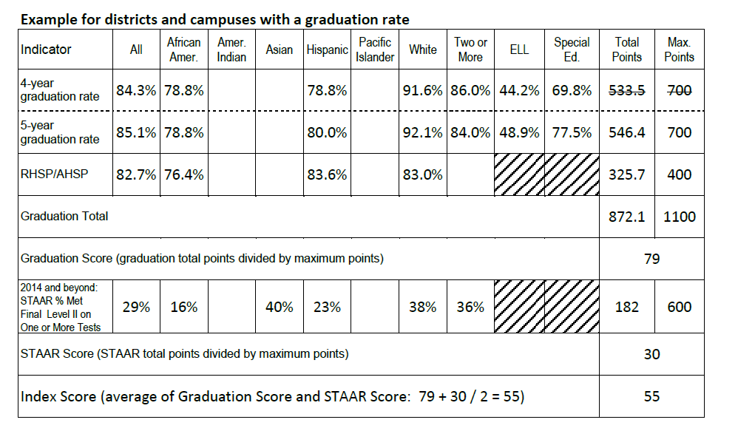
Index 4: Postsecondary Readiness
Index 4 Construction

Slide 28
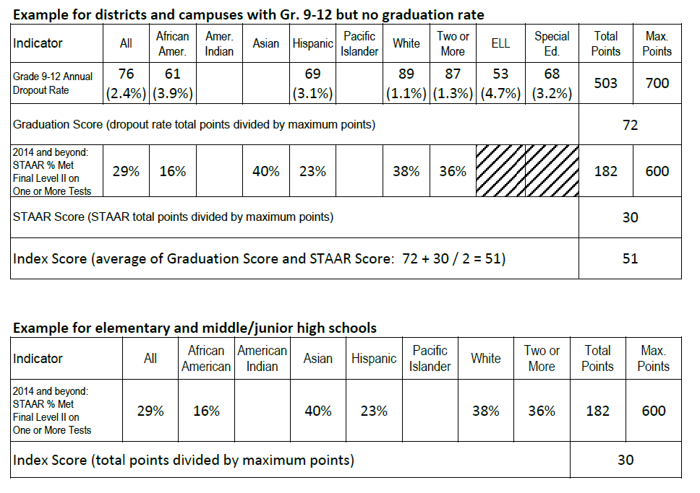
Index 4: Postsecondary Readiness
Index 4 Construction

Slide 29
Overview of Proposed Performance Index Framework (As of Feb. 28th, 2013)

Slide 30
Rating Labels?

Slide 31
Implications
A focus on every kid and perhaps a renewed emphasis on SLR.
Growth mindset at the secondary level?
A renewed emphasis on serving the brightest and high achieving students.
Not easy for stakeholders to understand

Slide 32
Bibliography
Lead4ward -- http://lead4ward.com/
TEA Accountability
http://ritter.tea.state.tx.us/perfreport/account/2013/index.html

